Slide 1
Serial Peripheral Interface
(SPI)
By: Dr Mitesh Limachia
This Presentation was created by Prof. Mitesh Limachia @Dharmsinh Desai University.
Please don’t use/present anywhere. Please use for study purpose only.

Slide 2
The Serial Peripheral Interface (SPI) Bus is a synchronous serial data protocol standard named by Motorola, operates in full duplex mode.
4 wires bus protocol (Clock line (1), Data line (2), Slave select line (1)).

Slide 3
SPI Bus Characteristics
One Central device (Master), initiates communication with all slave devices.
Master activates the clock signal when wishes to send the data to slave or request information from the slave.
Master sends 8 to 16 bits of data to the slave, while the slave can always able to send a byte size data to the master.

Slide 4
Multiple slave devices are connected on the bus with individual slave select (chip select) lines.
No addressing mechanism required to select slave.
Not have acknowledgement mechanism to confirm receipt of data -- not have flow control.
SPI Master, not have knowledge of whether slave exist or Not

Slide 5
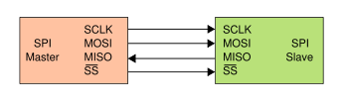
SPI Pin Description
Master send information on one line (MOSI)
while samples (read) from another line (MISO).

Slide 6
Contd.
SCLK — Serial Clock (output from master)
MOSI — Master Output, Slave Input (output from master)
MISO — Master Input, Slave Output (output from slave)
SS’ — Slave Select (active low; output from master)

Slide 7
Pin Name :SCK (Serial Clock)
Type :Input / Output
The SPI uses clock signal to synchronize the data transfer across the SPI interface.
Driven by the master and received by the slave, The clock is programmable to be active high or active low.
The SCK is only active during a data transfer. Any other time, it is either in its inactive state, or tri-stated.

Slide 8
Pin Name : MOSI
(Master out Slave in)
Type : Input / Output
The MOSI signal is a unidirectional signal used to transfer serial data from the Master to the Slave.
When a device is a Master, serial data is output on this signal.
When a device is a Slave, serial data is input on this signal.

Slide 9
Pin Name : MISO (Master in Slave out)
Type : Input / Output
The MISO signal is a unidirectional signal used to transfer serial data from the slave to the master.
When a device is a slave, serial data is output on this signal.
When a device is a master, serial data is input on this signal.
Slave device which is not selected, it has to drive this signal into high impedance state.

Slide 10
Pin Name : SSEL (Slave Select)
Type : Input
Each slave has its own unique slave select signal input.
The SSEL’ is an active low signal indicates which slave is currently selected to participate in a data transfer.
The SSEL must be low before data transmission begin and normally stays low for the duration of the transmission.
If the SSEL signal goes high any time during a data transfer, the transfer is considered to be aborted.

Slide 11
Operation
The SPI bus can operate with a single master device and with one or more slave devices
SPI bus: Single Master and Single Slave

Slide 12
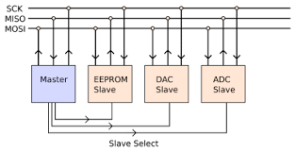

Slide 13
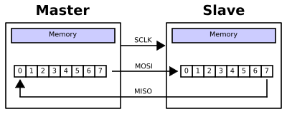
Full Duplex Data Transmission
Typical hardware setup uses two shift registers to form an inter-chip circular buffer.
Transmissions normally involve two shift registers of some size, such as eight bits, one in the master and one in the slave; they are connected in a ring.
SS’

Slide 14
To begin a communication, the master first configures the Clock, using a frequency less than or equal to the maximum frequency the slave device supports.
The master then pulls the slave select SSEL (SS’) low for the desired slave.
The master sends a bit on the MOSI line; the slave reads it from that same line.
The slave sends a bit on the MISO line;
the master reads it from that same line

Slide 15
During each SPI clock cycle, a full-duplex data transmission occurs.
After the total 8^{h} clock pulses content of shift register has been shifted out. Master and slave have exchanged values.

Slide 16
Multiple slave Configurations
Two types of multiple slave configuration:
Typical SPI bus: Master and independent Slaves
Daisy-Chained SPI bus: Master and Co-operative Slaves

Slide 17
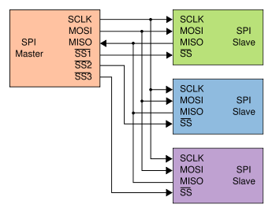
Typical SPI Bus
With multiple slave devices, an independent SS’ signal is required from the master for each slave device (3).

Slide 18
In the independent slave configuration, there is an independent slave select line (SS’) for each slave. This is the way SPI is normally used.
Since the MISO pins of the slaves are connected together, they are required to be tri-state pins.
When a slave device is not selected, the slave drives this signal into high impedance state.

Slide 19
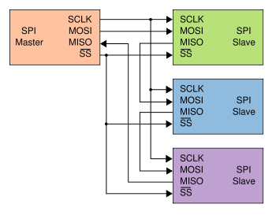
Daisy-Chained SPI Bus
Daisy-chained SPI bus: Master and Cooperative
Slaves

Slide 20
Some products with SPI bus are designed to be capable of being connected in a daisy chain configuration, the first slave output being connected to the second slave input, etc.
The SPI port of each slave is designed to send out during the second group of clock pulses an exact copy of what it received during the first group of clock pulses.
Such a feature only requires a single SS’ line from the master, rather than a separate SS’ for each slave.

Slide 21
Contd.
All the slave devices in chain will be involved in a write or read operation.
Daisy Chained simplifies the connection by reducing the length and connections of the data lines.
Speed would be less.
It restricts access to a single device in chain.

Slide 22
Comparison
Typical SPI Bus- Control each slave separately. Allowing connection of SPI devices that require different clocking schemes.
If SPI slaves that operate using different clocks (edges/idle states) , we can re-programme the master SPI interface before enabling specific SS’ for particular slave. It provides Flexibility.
Daisy chained SPI Bus- Make sure all the slave use the same clock edge and idle clock state.

Slide 23
Data Transmission
Clock polarity and phase
In addition to setting the clock frequency, the
master can configure the clock polarity and phase with respect to the data.

Slide 24
Contd.
CPOL: Clock Polarity
This governs the initial logic state of the clock signal.
CPHA: Clock Phase This governs the relationship between the data transitions and the clock transitions.

Slide 25
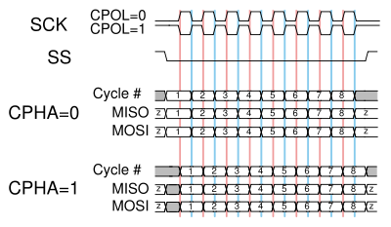
Data Transmission
A timing diagram showing clock polarity and phase

Slide 26
Contd.
At CPOL=0, the base value of the clock is zero
For CPHA=0, data are read on the clock's
rising edge and data are changed on a falling edge.
For CPHA=1, data are changed on a rising
edge and data are read on the clock's falling edge.

Slide 27
Contd.
At CPOL=1, the base value of the clock is one
For CPHA=0, data are read on clock's falling edge and data are changed on a rising edge.
For CPHA=1, data are read on clock's rising edge and data are changed on a falling edge.

Slide 28
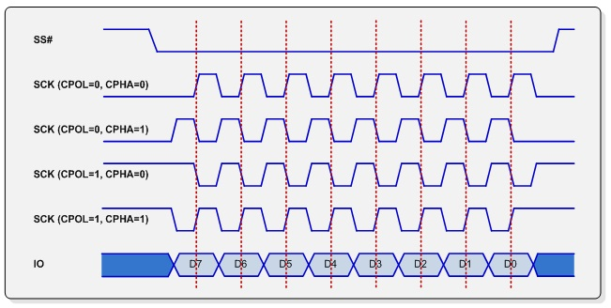

Slide 29
Data Transmission
CPHA=0 means data sample (read) on the
leading (first) clock edge
CPHA=1 means data sample on the trailing (second) clock edge, regardless of whether that clock edge is rising or falling.
For correct data transfer, the CPOL and CPHA bits must be configured in the same way in the slave device and the master device.

Slide 30
Programming of SPI

Slide 31
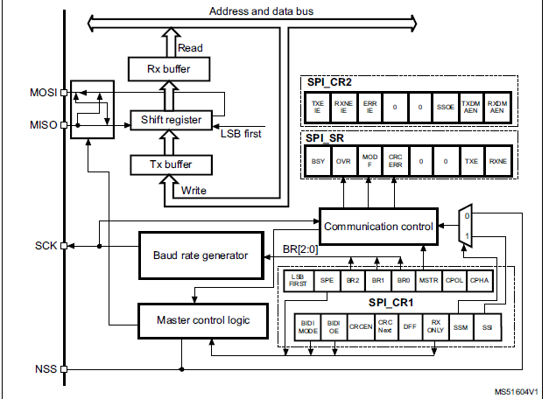

Slide 32

SPI Control Register 1 (SPI_CR1)
Bit 0 CPHA: Clock phase
0: The first clock transition is the first data capture edge
1: The second clock transition is the first data capture edge
Bit1 CPOL: Clock polarity
0: CK to 0 when idle
1: CK to 1 when idle
Bit 2 MSTR: Master selection
0: Slave configuration
1: Master configuration

Slide 33
Contd.
Bits 5:3 BR[2:0]: Baud rate control
000: fPCLK/2 001: fPCLK/4 010: fPCLK/8
011: fPCLK/16 100: fPCLK/32 101: fPCLK/64
110: fPCLK/128 111: fPCLK/256
Bit 6 SPE: SPI enable
0: Peripheral disabled 1: Peripheral enabled
Bit 7 LSBFIRST: Frame format
0: MSB transmitted first 1: LSB transmitted first
Bit 11 DFF: Data frame format
0: 8-bit data frame format is selected
1: 16-bit data frame format is selected

Slide 34

SPI Data Register (SPI_DR)
Bits 15:0 DR[15:0]: Data register
Data to be transmitted or received Data
The data register is split into 2 buffers - one for writing (Transmit Buffer) and another one for reading (Receive buffer).
A write to the data register will write into the Tx buffer and a read from the data register will return the value held in the Rx buffer.

Slide 35
- When data are written into the SPI_DR register (Tx buffer).
-Data are parallel loaded from the Tx buffer into the 8-bit shift register during the first bit transmission and then shifted out serially to the MOSI pin.

Slide 36
Contd.
For the Master receiver, when data transfer is received:
The Data in shift register is transferred to Rx Buffer.

Slide 37

SPI Status Register (SPI_SR)
Bit 7 BSY: Busy flag
0: SPI not busy
1: SPI is busy in communication or Tx buffer is not empty. This flag is set and cleared by hardware.
Bit 1 TXE: Transmit buffer empty
0: Tx buffer not empty 1: Tx buffer empty
Bit 0 RXNE: Receive buffer not empty
0: Rx buffer empty 1: Rx buffer not empty
TXE and RXNE bits are set and cleared by hardware.

Slide 38
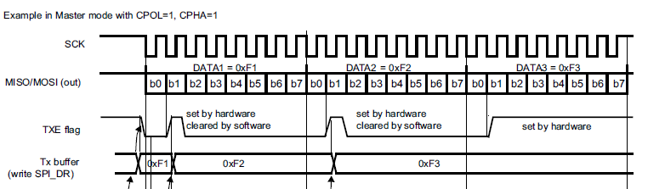
The TXE flag is set on the transfer of data from the Tx Buffer to the shift register. Note that TXE flag should be ‘1 before any attempt to write the Tx buffer is made.

Slide 39
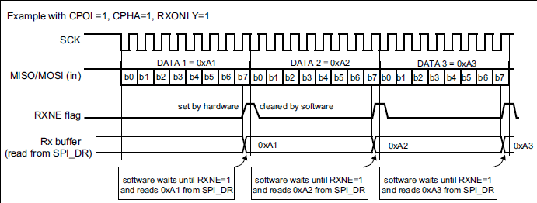
After the last sampling clock edge the RXNE bit is set, a data byte received in the shift register is moved to the Rx buffer. RxNE=‘1’
When the SPI_DR register is read, the SPI peripheral returns this buffered value.
Clearing of the RXNE bit is performed by reading the SPI_DR register.

Slide 40
Configuring the SPI in Master Transmitter Mode
In the master configuration, the serial clock is generated on the SCK pin.
Procedure
1. Select the BR[2:0] bits to define the serial clock baud rate (see SPI_CR1 register).
2. Select the CPOL and CPHA bits to define one of the four relationships between the data transfer and the serial clock.
3. Set the DFF bit to define 8- or 16-bit data frame format
4. Configure the LSBFIRST bit in the SPI_CR1 register to define the frame format.

Slide 41
Contd.
5. The MSTR and SPE bits must be set.
In this configuration the MOSI pin is a data output and the MISO pin is a data input.

Slide 42
Transmit Sequence
The transmit sequence begins when a byte is written in the Tx Buffer.
The data byte is parallel-loaded into the shift register during the first bit transmission and then shifted out serially to the MOSI pin.
The TXE flag is set on the transfer of data from the Tx Buffer to the shift register .
A continuous transmit stream can be maintained if the next data to be transmitted is put in the Tx buffer once the transmission is started. Note that TXE flag should be ‘1 before any attempt to write the Tx buffer is made.

Slide 43
Pros and Cons
Of
SPI

Slide 44
Advantages
Full duplex communication
Higher throughput than I²C
Complete protocol flexibility for the bits
transferred
  * Not limited to 8-bit words
  * Arbitrary choice of message size

Slide 45
Disadvantages
Requires more pins on IC packages than
I²C.
No hardware slave acknowledgment (the master could be "talking" to nothing and not know it).
No hardware flow control

Slide 46
Disadvantages
Supports only one master device
Only handles short distances compared
to RS-232, RS-485, or CAN-bus

Slide 47
Comparison between I²C & SPI
Parameter | I²C | SPI
Speed | 100/400 kbps | 1MBPS
Number of Pins | 2-wire | 4-wire
Complexity | More | Less
Multi Master Capability | Yes | No
Reliability (data transmission) | Higher | Lower
Flow Control | Yes | No
More devices on board | Preferred | Not Preferred
Power Efficiency | Lower (pull-up Resistors) | Higher

